Slide 1
Romanian voice control system based on Tensorflow and Raspberry Ri
Tohaneanu Andrei-dUMITRU

Slide 2
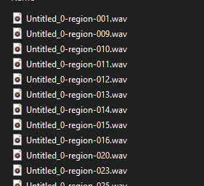
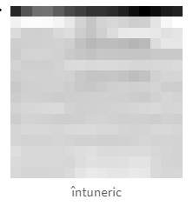
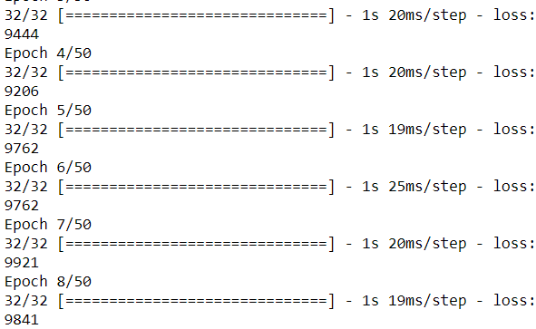
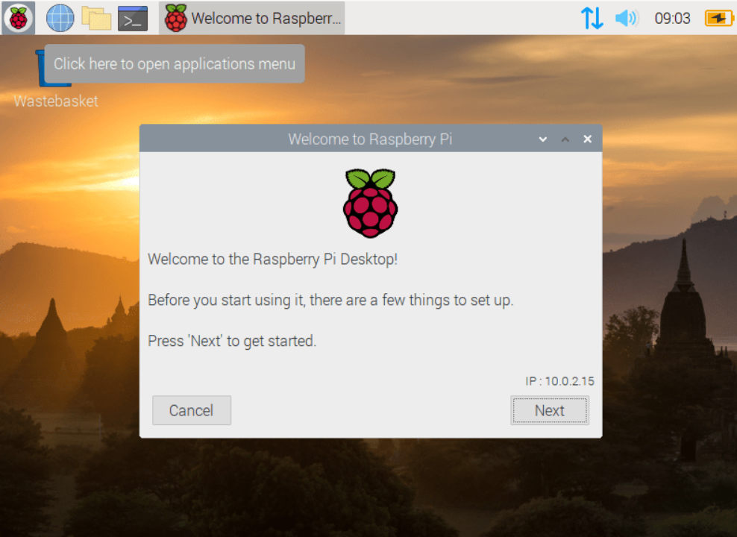
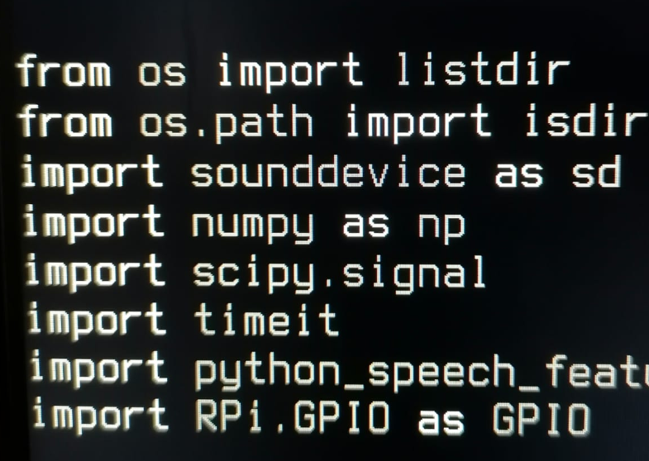
PROJECT STAGES:
Data collection
Feature extraction
Model training and testing
System preparation
Implementation

Slide 3
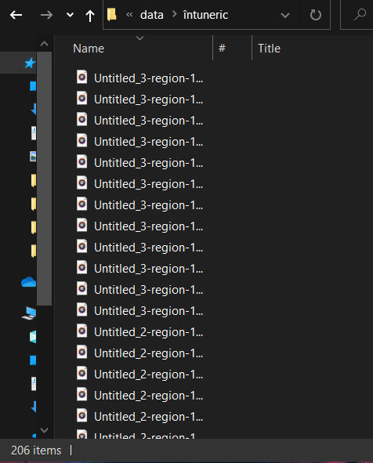
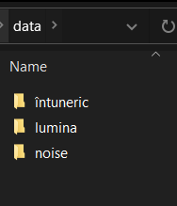
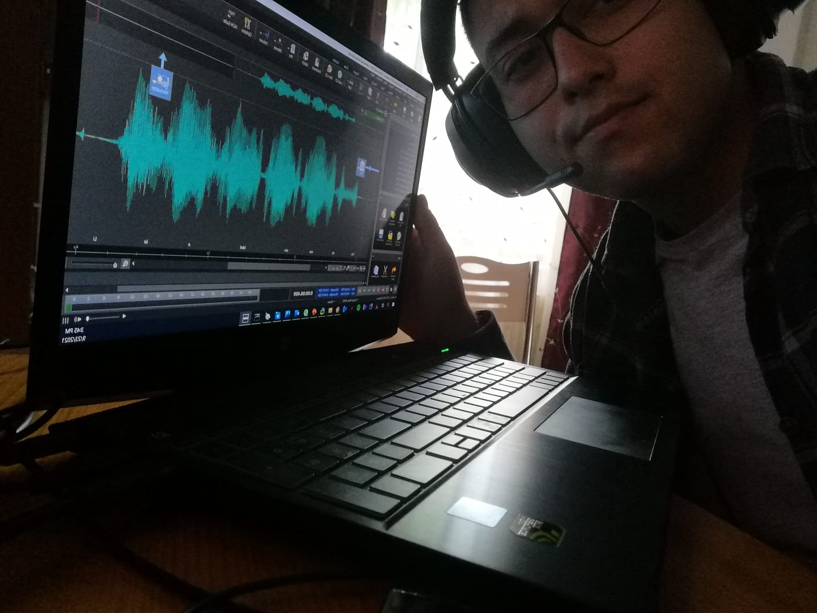
Data collection

Slide 4
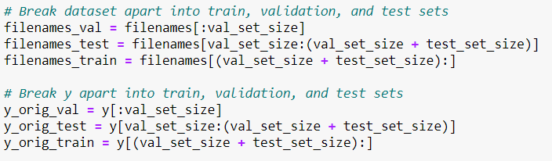
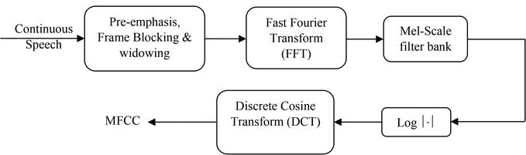
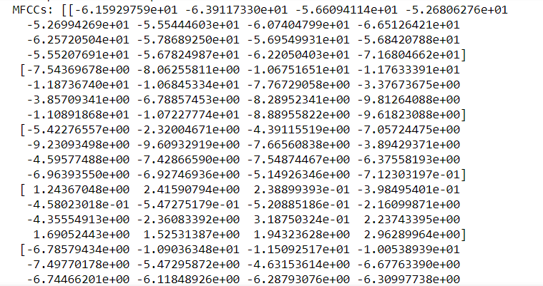
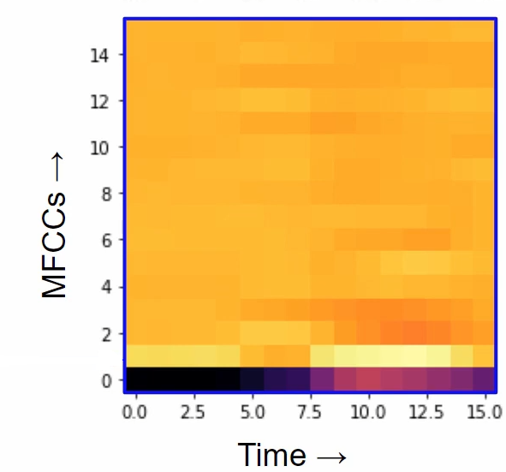
Feature extraction
Sharing the data set for training, validation and testing:
Extraction of characteristics using Mel-frequency cepstral coefficients (MFCCs)

Slide 5
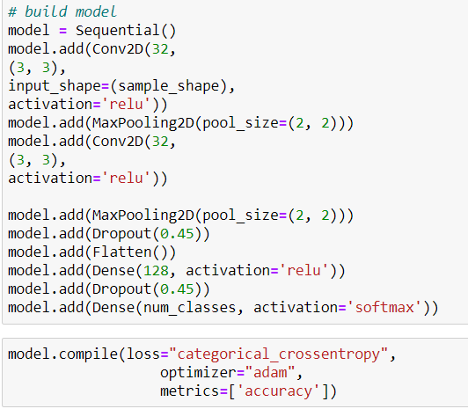
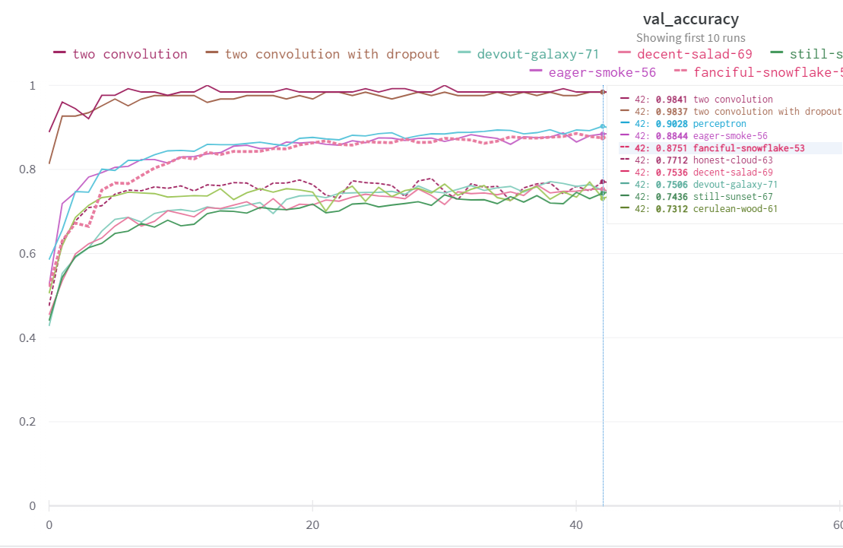
Model training and testing
Creating and establishing the right model
Convolutional neural network (CNN) - the most used neural network in image analysis

Slide 6
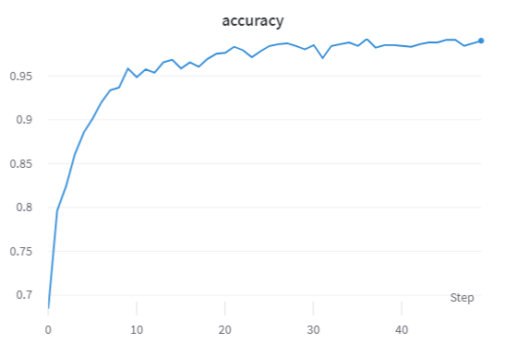
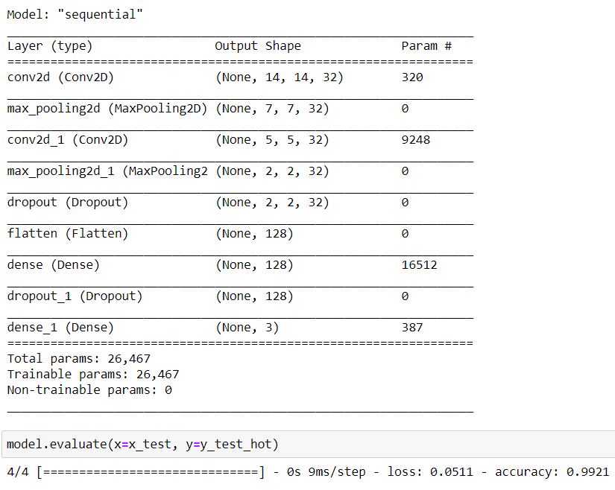
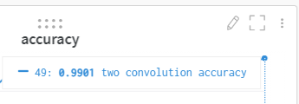
Model training and testing
2. Training and testing

Slide 7
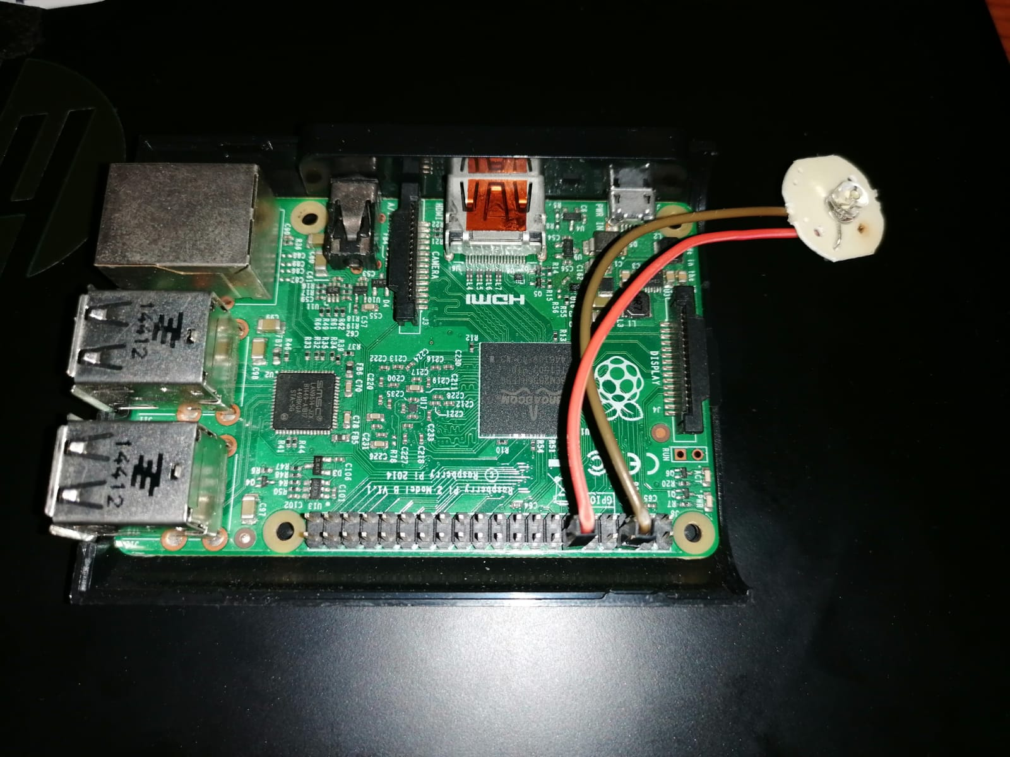
System preparation

Slide 8
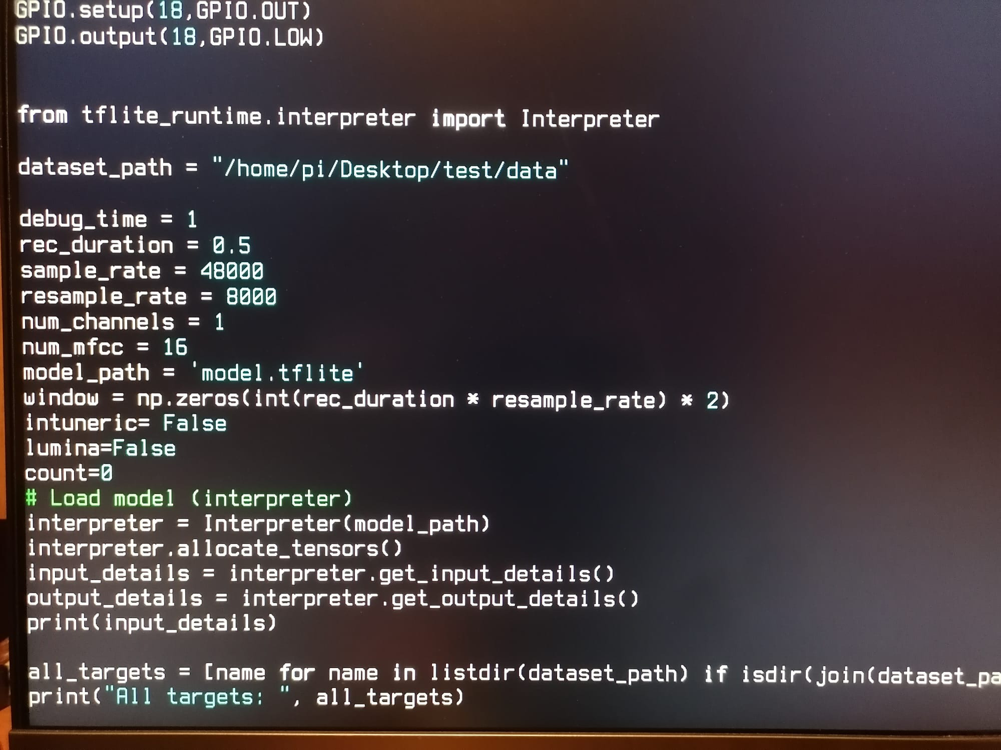
Implementation
Used libraries:
tensorflow
Kerasia
wandb
librosa
random
RPi
python_speech_features
numpy
sounddevice
bone
tflite_runtime

Slide 9
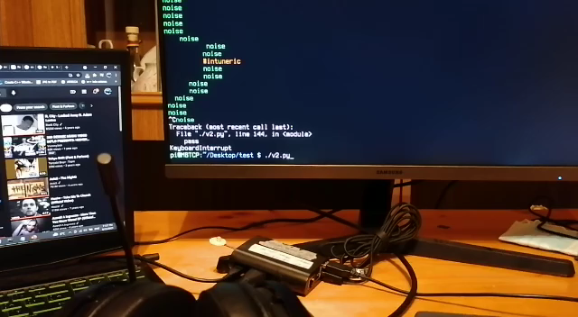
The final result
Observations during the test:
In perfect condition it did not work several times, for „întuneric".
Due to the noise, the ‘lumina’ is rarely activated without being the case, and the ‘întuneric’ is harder to perceive.
** background music is to be able to observe the operation affected by noise **

Slide 10
Thanks for watching!

